Slide 1
RNN Recurrent Neural Networks
By Shravan Chandrashekharaiah
ID: 18043038

Slide 2
Topic
What is Neural Network
Popular Neural Network
Why Recurrent Neural Network
What is Recurrent Neural Network
How does a RNN work
Vanishing Gradient Problem
Long Short Term Memory

Slide 3
Intro to Neural Network
Google’s autocomplete feature to predict the next word user is typing.
Collect Huge amount of data Collection of Large volume of most frequently occuring words
Fed to RNN Analyses the data by finding the sequence of words occurring frequently and builds a model to predict the next word in the sentence
Evaluate Where do you get best food in Las ____

Slide 4
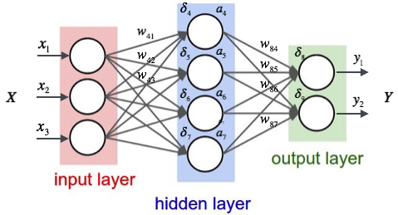
What is Neural Network?
Neural Network used in Deep Learning, consists of different layers connected to each other and work on the structure and functions of human brain. It learns from huge volumes of data and uses complex algorithms to train a neural network.
Important point here is, such networks do not require to memorize the past input

Slide 5
Popular Neural Networks
Feed Forward Neural Network Used in general Regression and Classification problems
Convolution Neural Network Used for Image Recognition
Deep Neural Network Used for Acoustic Modeling
Deep Belief Network Used for Cancer Detection
Recurrent Neural Network Used for Speech Recognition

Slide 6
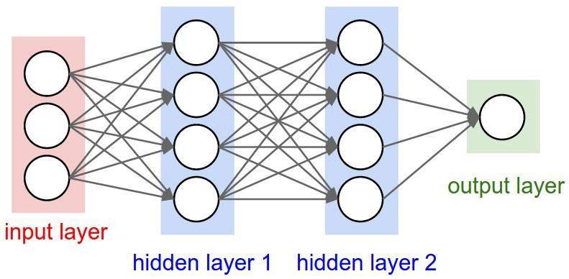
Feed Forward Neural Network
In a Feed-Forward Network, information flows only in forward direction, from the input nodes, through the hidden layers (if any) and to the output nodes. There are no cycles or loops in the network
Decisions are based in current input
No memory about the past
No future scope

Slide 7
Why Recurrent Neural Network
Issue in Feed Forward Neural Network
Cannot handle sequential data
Considers only the current input
Cannot memorize previous inputs

Slide 8
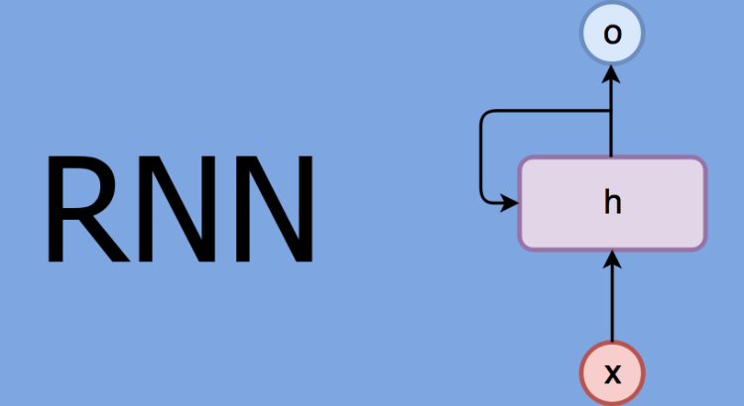
Why Recurrent Neural Network
Solution to Feed Forward Neural Network
Can handle sequential data
Considers the current input and also the previously received inputs
Can memorize previous inputs due to its internal memory

Slide 9
Application of RNN
Image Captioning RNN is used to caption an image by analyzing the activities present in it
Time Series Prediction Any time series problem like predicting the prices of stocks in a particular month can be solved using RNN
Natural Language Processing Text mining and sentiment analysis can be carried out using RNN for Natural Language Processing
Machine Translation Given an input in one language, RNN can be used to translate the input into different languages as output

Slide 10
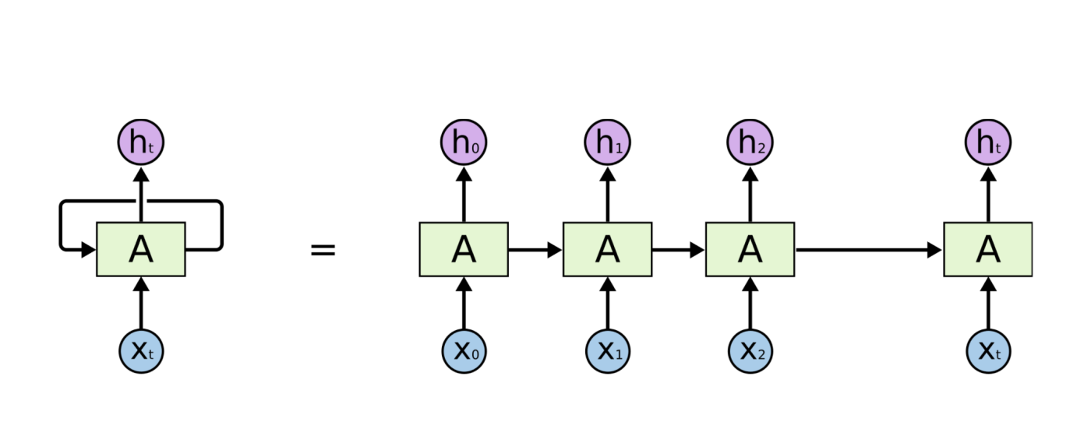
How does RNN looks like

Slide 11
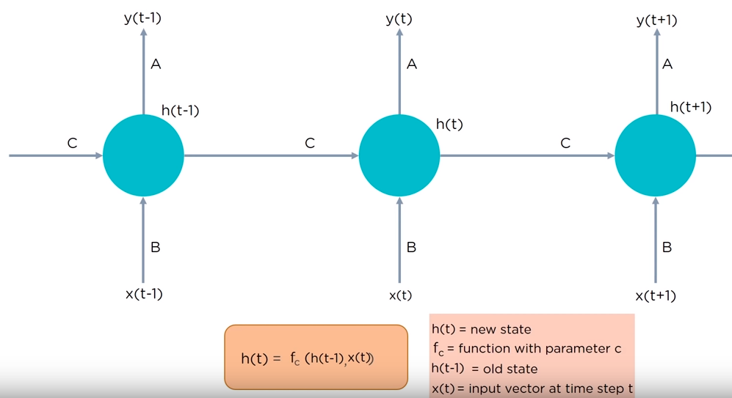
How does RNN looks like

Slide 12
Types of RNN
One to One one to one network is known as the vanilla neural network. Used for regular machine learning problems
One to Many one to many network generated sequence if outputs. Example: image processing
Many to one many to one networks takes in a sequence of inputs. Examples: sentiment analysis where a given sentence can be classified as expressing positive or negative sentiments
Many to Many many to many network takes in a sequence if inputs and generates a sequence of outputs. Example: Machine Translation

Slide 13
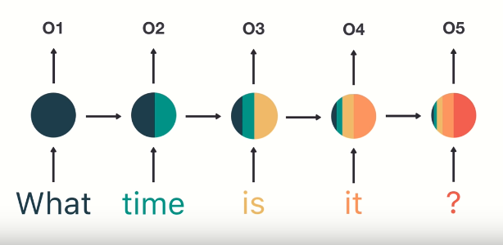
Vanishing Gradient Problem
RNN can't deal with long term dependencies and struggle with the problem of vanishing gradients. After a certain gap, it will not be able to contain the context information.

Slide 14
Long Short-Term Memory Networks (LSTM)
LSTMs are special kind of Recurrent Neural Networks, capable of learning long-term dependencies. Remembering information for long periods of time is their default behavior.
All recurrent neural networks have the form of a chain of repeating modules of neural network. In standard RNNs, this repeating module will have a very simple structure, such as a single tanh layer.
LSTMS also have a chain like structures, but the repeating module has a different structure. Instead of having a single neural network layer, there are four interacting layers communicating in a very special way.

Slide 15
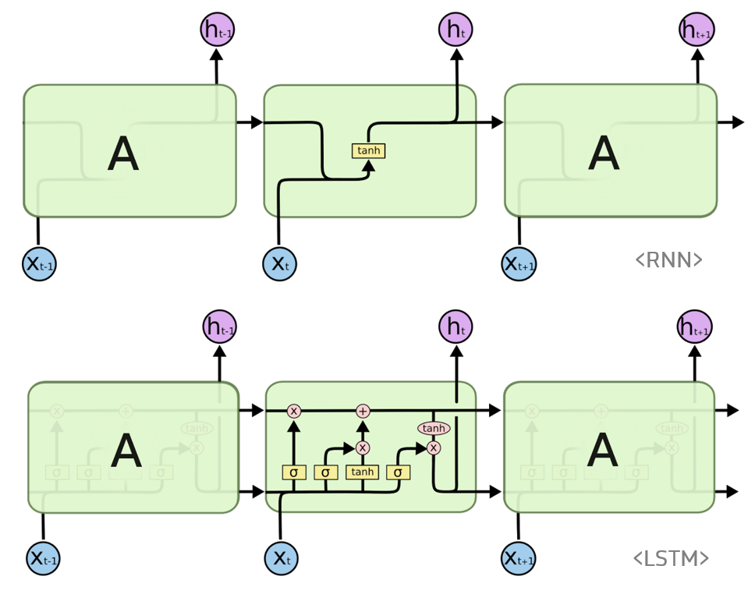
Long Short-Term Memory Networks (LSTM)

Slide 16
Working of LSTM
Step one Decide how much of the past it should remember. Decide which information to be omitted in from the cell in that particular time step. It is decided by the sigmoid function. It looks at the previous state and current input and compute the function
Step two Decide how much this unit add to the current state. In second layer there are two layers. One is sigmoid function and the other is the tanh. In the sigmoid function, it decides which values to let through. Tanh function gives the weightage to the values which are passed deciding their level of importance.
Step three Decides what part of the current cell state makes it to the output. First we run a sigmoid layer which decides what part of the cell state make it to the output.

Slide 17
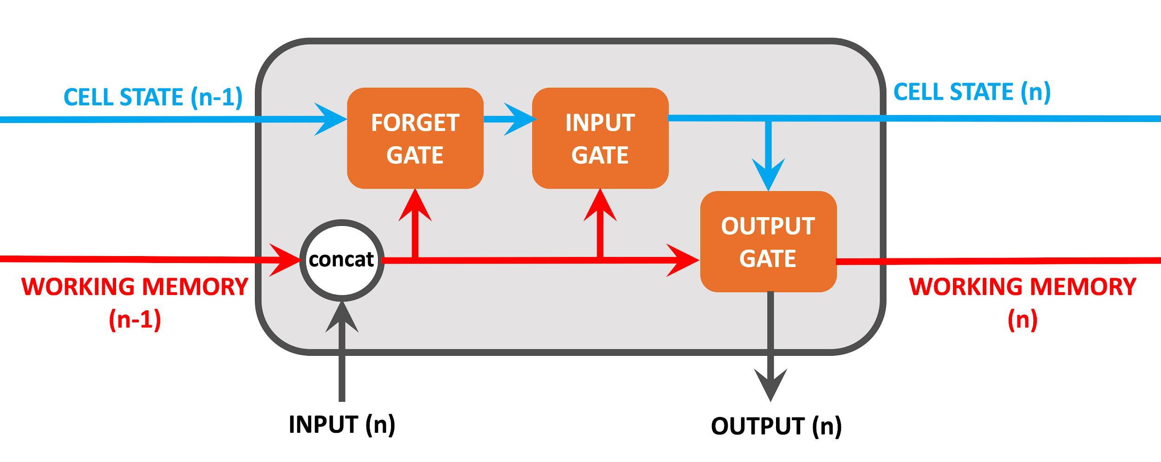
Working of LSTM

Slide 18
References
http://colah.github.io/posts/2015-08-Understanding-LSTMs/
https://builtin.com/data-science/recurrent-neural-networks-and-lstm

